Slide 1

Work done by a spring
Work done by pumping a liquid

Slide 2
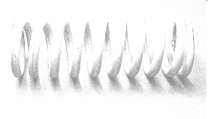
Work done by a spring

Slide 3

HOOKE’S LAW
Hooke’s Law states that within the limits of elasticity the displacement produced in a body is proportional to the force applied, that is,
F = kx,
where the constant k is the constant of proportionality called the modulus.
Thus , F(x) = kx
The work done is

Slide 4
3. A spring has a natural length of 10 inches. An 800-lb force stretches the spring 14-inches. (a) Find the force constant. (b) How much work is done in stretching the spring from 10 inches to 12 inches? (c) How far beyond its natural length will a 1600-lb. force stretch the spring?
1. If the modulus of a spring is 20 lbs./in., what is the work required to stretch the spring a distance of 6 inches?
2. If a force of 50 lbs. stretches a 12 in. spring to 14 in., find the work done in stretching the spring from 15 in. to 17 in.

Slide 5
3. A spring has a natural length of 10 inches. An 800-lb force stretches the spring 14-inches. (a) Find the force constant. (b) How much work is done in stretching the spring from 10 inches to 12 inches? (c) How far beyond its natural length will a 1600-lb. force stretch the spring?

Slide 6
4. A force of 200 N will stretch a garage door spring 0.8-m beyond its unstressed length. How far will a 300-N-force stretch the spring? How much work does it take to stretch the spring this far?
SOLUTION:
To determine how far a 300-N-force will stretch the spring, we must first determine the force constant using F= kx.
200 = 0.8k k = 250 N /m
Thus , F= 250x
300 = 250x x = 1.2 m

Slide 7
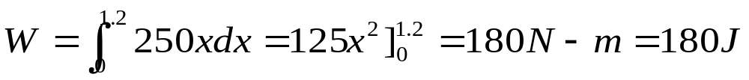
To determine the work done to stretch the spring this far,

Slide 8
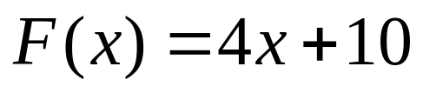
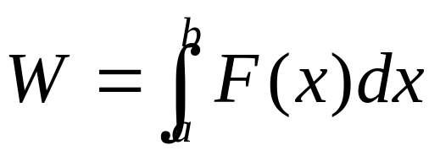
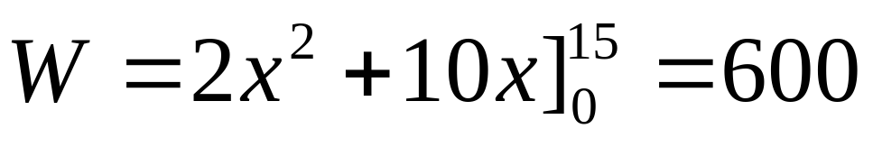
4. A crate is pushed a distance of 15 meters. If it is pushed with a force equvalent to 4x + 10 newtons, how much work was done to move the crate?
SOLUTION:
Joules

Slide 9
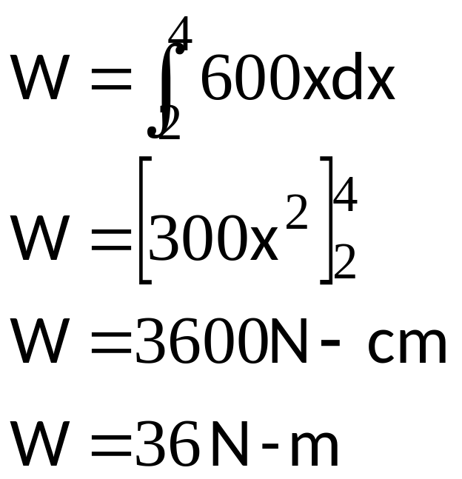
5. A force of 1200 N compresses a spring from its natural length of 18 cm to a length of 16 cm. How much work is done in compressing it from 16 cm to 14 cm?
SOLUTION:
F = kx
1200 = k(2)
k = 600 N /cm Thus F (x)= 600x

Slide 10
Work done by pumping

Slide 11
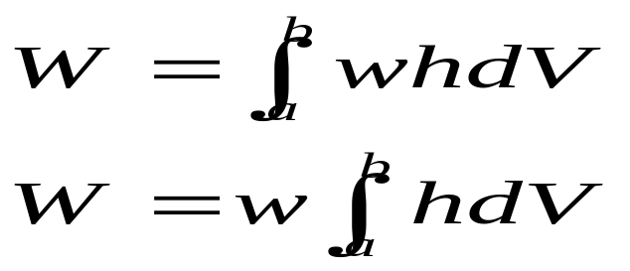
Work done in Pumping a Liquid
The total work done in lifting all or part of the liquid in a container to any point P above its top is
where w = weight per unit volume of the liquid
h = distance of the element from the
point P
dv = volume of the solid generated by
revolving the element

Slide 12

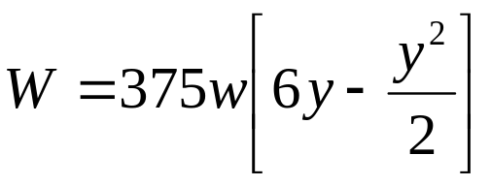

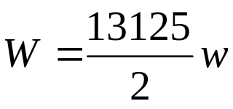
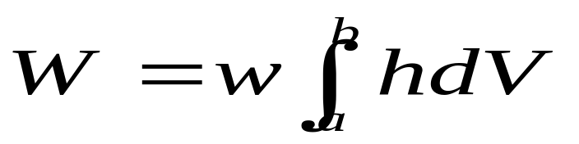
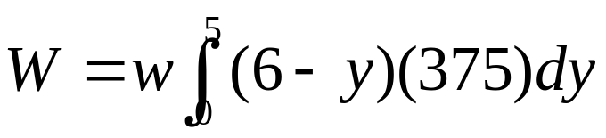
EXAMPLE
1. A swimming pool full of water is in the form of a rectangular
parallelepiped 5 m deep, 25 m long and 15 m wide. Find the
work required to pump the water in the pool up to a level one
meter above the surface of the pool.
for the element of the volume,
5
0
dyne-m
using

Slide 13
h= 6-y
6
y
25
5
15

Slide 14
EXAMPLE
2. The inner surface of a tank has the form of a parabola of revolution whose axis is vertical. The depth of the tank and the diameter of the circular top are 12 cm. If the tank is originally full of water, find the work done in pumping all the water:
To the top
3 cm from the top
Suppose the tank is half-full in (a)

Slide 15
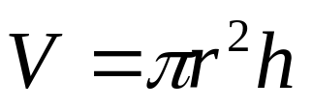
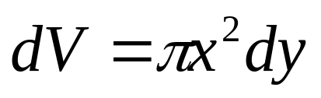



y
(6,12)
r =6
h= 12 - y
12
y
x
for the element of the volume, (strip is in the form of a cylinder) thus
to find the equation of the parabola, we use and substitute the
coordinates of the point (6,12) to find 4a.

Slide 16


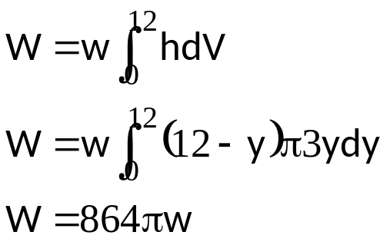
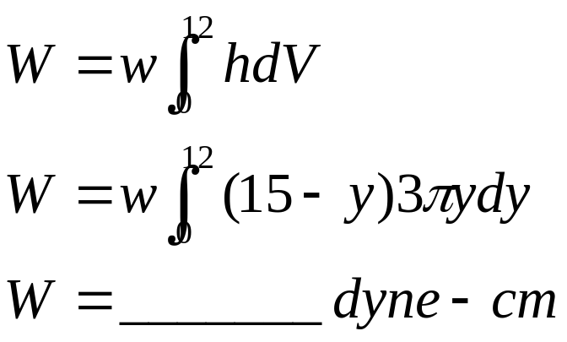
Thus , substitute in
a.
dyne-cm
b. If the water is to be pumped 3 cm above its surface, the only value which will
change is h; h = 15-y
Thus

Slide 17
If the tank is half-full, just change the limit of (a) from 0 to 6 since the
container is half-full.

Slide 18
1. A conical vessel full of water is 16 ft. across the top and 12 ft. deep. Find the work required to pump all the water to a point 2 ft above the top of the vessel.
EXERCISES
2. A tank is in the shape of a right circular cone with height 5 m and top radius 2 m. It contains water up to the height of 4 m. The density of water is 1,000 kg/m³. How much work must be done to pump all of the water out of the tank over the top edge of the tank?
3. Suppose that a cylindrical tank has height 10, the radius of the base is 7, and it is half filled with water. Find the amount of work necessary to move all of the water out of the top of the tank.

